Slide 1



Erasmus+ Programme – KA220-VET - Cooperation partnerships in vocational education and training
INCLUDE - 2023-1-RO01-KA220-VET-000160043
Expected Outcomes: Driving Inclusive Employment through Legal and Organisational Excellence
Equipping organisations with the knowledge, capacity, and practical tools to champion inclusive employment across the European Union.

Slide 2

Increased Legal and Practical Knowledge of EU and National Legislation
EU's Evolving Legal Landscape
Compliance & Protection
National Alignment
French Supreme Court rulings exemplify alignment of national law with EU standards on paid leave and overtime, enhancing worker rights.
Key updates including the EU AI Act and Pay Transparency Directive coming into force by 2026-2027, reshaping employment frameworks across member states.
Understanding these laws ensures regulatory compliance whilst leveraging critical protections for vulnerable workers throughout the organisation.

Slide 3


Improved Organisational Capacity to Support Inclusive Employment
The Readiness Challenge
Only 18-24% of organisations report being very prepared for new EU employment laws according to the Littler 2025 survey, highlighting a critical capacity gap.
Building internal task forces and conducting comprehensive audits on pay equity and AI use cases are essential first steps towards readiness.
Case Study: The EU Disability Employment Package focuses on strengthening employment services and reasonable accommodations, providing a blueprint for organisational transformation.

Slide 4




Identification of Transferable Legal and Policy Elements
EU-wide directives provide robust frameworks adaptable across member states, enabling shared learning and efficient policy implementation.
Affirmative Action Catalogues
Structured approaches to promoting diversity and equal opportunities within recruitment and advancement processes.
Vocational Rehabilitation Schemes
Comprehensive programmes supporting skill development and career progression for vulnerable workers.
Inclusive Hiring Practices
Evidence-based recruitment strategies removing barriers and expanding talent pools across demographics.
The EU Disability Employment Package's six action areas are specifically designed for broad applicability and effective national implementation across diverse contexts.

Slide 5
Concrete Proposals for Employers and Policymakers
For Employers
For Policymakers
Implement comprehensive pay transparency audits to identify and address wage gaps
Promote holistic, person-centred labour market policies addressing systemic barriers
Establish dedicated diversity and inclusion task forces with clear mandates and resources
Support initiatives benefiting women, migrants, older workers, and persons with disabilities
Adopt flexible work arrangements accommodating diverse needs and circumstances
Drive pension reforms and affordable care services to increase participation
Invest in accessibility infrastructure and assistive technologies
Facilitate knowledge-sharing platforms across member states
Example: Pension reforms and affordable care services have demonstrably increased labour participation rates according to the ESDE 2025 report.

Slide 6
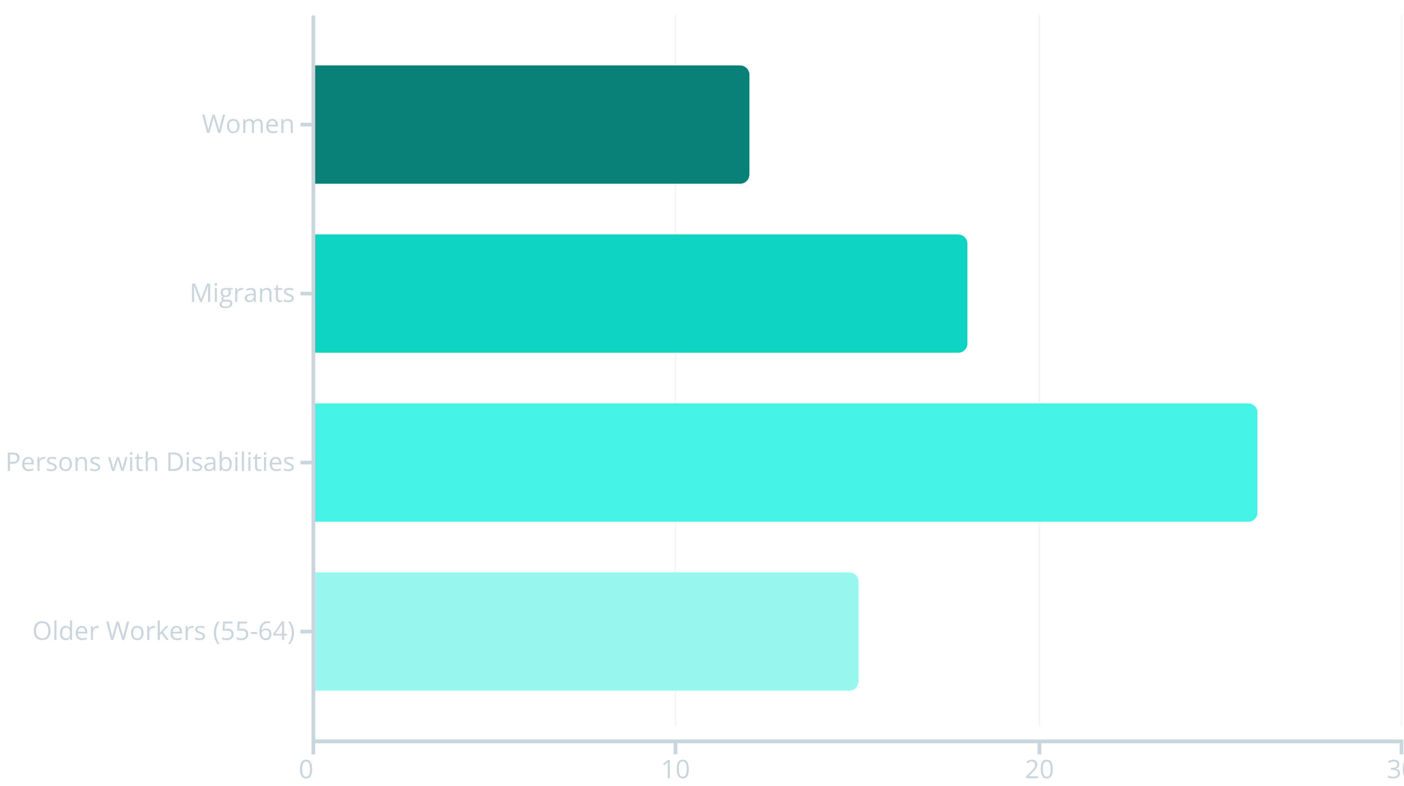
The Stakes: Labour Market Inclusion as a Solution to Demographic Challenges
18M
78%
Projected Workforce Decline
Employment Rate Target
EU workforce expected to shrink by up to 18 million workers by 2050 due to demographic shifts.
EU's ambitious target for employment rate by 2030, requiring inclusive policies to achieve.
Inclusive employment policies are critical not only for social justice but for maintaining economic competitiveness and sustainability across the European Union.

Slide 7

Legal Compliance as a Foundation for Inclusion and Competitiveness
Non-Compliance Risks
Compliance Dividends
Expanding Obligations
Significant financial penalties under the EU AI Act and Pay Transparency Directive, alongside reputational damage and legal exposure.
Enhanced employer brand, increased stakeholder trust, improved employee engagement, and sustainable productivity gains.
European Works Council Directive reforms expanding worker rights and employer obligations by 2028, requiring proactive preparation.

Slide 8

Organisational Transformation: From Awareness to Action
01
02
03
Legal Literacy Training
Policy Embedding
Continuous Improvement
Comprehensive programmes to increase understanding of EU and national employment legislation among HR professionals and management teams.
Integration of inclusive policies into corporate culture, operational processes, and performance management systems.
Regular audits, feedback mechanisms, and adaptation based on emerging best practices and regulatory developments.
"Companies adopting reasonable accommodation guidelines report improved retention rates and significantly enhanced engagement amongst employees with disabilities."

Slide 9




Collaborative Policy Development and Advocacy
Civil Society Engagement
Employer Organisations
Essential role of civil society organisations in shaping inclusive employment measures and ensuring accountability.
Industry groups driving practical implementation and sharing best practices across sectors and member states.
EU Commission Support
Diverse Disability Perspectives
Ongoing publication of practical tools and comprehensive guidelines to support implementation efforts.
Reflecting experiences of deaf communities, chronically ill workers, and others in policy development.

Slide 10

Unlocking Potential through Knowledge, Capacity, and Concrete Action
Mastery of Legal Frameworks
Enhanced Organisational Capacity
Commitment to Action
Proactive compliance, continuous learning, and collaborative policy engagement build a truly inclusive labour market for all.
Deep understanding of EU and national legislation empowers organisations to design and sustain genuinely inclusive workplaces.
Translating policy into meaningful practice benefits vulnerable groups whilst strengthening the wider economy and social fabric.
The path forward requires dedication, resources, and partnership—but the rewards of a more inclusive, competitive, and resilient European labour market are well worth the investment.

