Slide 1



Erasmus+ Programme – KA220-VET - Cooperation partnerships in vocational education and training
INCLUDE - 2023-1-RO01-KA220-VET-000160043
Module 8 – Evaluation and Certification
Closing the Learning Loop
Transforming knowledge into measurable impact through structured evaluation, meaningful reflection, and recognised achievement.

Slide 2


Why Evaluate? The Power of Measuring Learning Outcomes
Confirms Mastery
Aligns Goals
Assessment validates that participants have truly grasped key skills and knowledge, ensuring training objectives are met.
Connects learning directly with organisational objectives and real-world application for maximum relevance.
Drives Improvement
Evidence-based evaluation creates accountability and fuels continuous enhancement of training programmes.

Slide 3

Assessing Learning Outcomes: Best Practices
Mixed Assessment Approach
Combine objective measures (quizzes, tests) with subjective evaluations (essays, reflections) to capture the complete picture of learning.
Provide timely, constructive feedback that supports ongoing learner growth and development.
Real-World Example: Stanford University's customisable course evaluations gather targeted feedback aligned to specific learning goals, focusing on patterns rather than isolated comments to identify meaningful insights.

Slide 4

Group Reflection and Feedback: Harnessing Collective Insight
01
02
03
Facilitated Discussions
Personal Reflection
Safe Space Creation
Structured group conversations encourage participants to share diverse perspectives, deepening collective understanding.
Reflection helps learners internalise lessons and identify both personal and team growth areas.
Establish an environment for honest feedback and collaborative problem-solving without judgement.
UW–Madison's course evaluations exemplify this approach, encouraging students to reflect on their own learning relative to stated outcomes.

Slide 5

Action Plans: From Learning to Organisational Impact
Create Personalised Plans
1
Participants develop concrete, tailored strategies to apply new knowledge directly in their roles.
Set SMART Goals
2
Establish objectives that are Specific, Measurable, Achievable, Relevant, and Time-bound for clear direction.
Track Implementation
3
Post-training follow-ups monitor progress and outcomes, ensuring accountability and measurable change.
Action plans bridge the gap between classroom learning and workplace transformation, turning theory into tangible results.

Slide 6
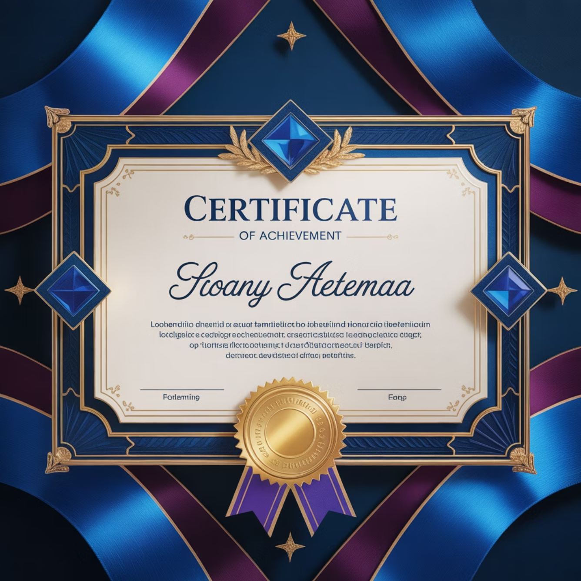
Certificates of Participation: Recognition and Motivation
Validate Achievement
Certificates formally recognise effort and accomplishment, boosting learner confidence and morale significantly.
Professional Proof
Serve as formal documentation for career progression and professional development portfolios.
Digital Sharing
Modern certificates can be shared on LinkedIn and professional networks, amplifying their value.
Encourage Growth
Reinforce programme value and inspire commitment to ongoing learning and development.

Slide 7





The Learning Journey
From Knowledge to Change
Assessment
Measure learning outcomes
Reflection
Deepen understanding
Action Planning
Create strategies
Certification
Recognise achievement
Impact
Transform organisations
Each stage builds upon the last, creating a comprehensive framework that transforms individual learning into organisational success.

Slide 8

Overcoming Challenges in Evaluation and Certification
Honest Feedback
Maintain anonymity whilst encouraging candid responses. Use secure digital platforms to protect participant identity and build trust.
Balanced Data
Integrate quantitative metrics with qualitative insights for comprehensive understanding. Numbers tell part of the story; narratives complete it.
Sustained Application
Encourage ongoing implementation beyond training through regular check-ins, peer support networks, and leadership reinforcement.
Technology Leverage
Utilise modern tools for efficient data collection, analysis, and reporting. Automation speeds insights whilst maintaining accuracy.

Slide 9

Success Story: Transforming Learning into Organisational Growth
The Challenge
A mid-sized organisation struggled to translate training into
tangible workplace improvements.
The Solution
Implemented structured evaluation, facilitated group reflection sessions, and personalised action plans with quarterly follow-ups.
25%
18
40%
Productivity Increase
Internal Promotions
Barrier Reduction
Within 6 months of programme completion
Supported by certificate credentials
Hidden obstacles uncovered through reflection
Group reflection sessions revealed previously hidden barriers and sparked innovative solutions that management hadn't anticipated.

Slide 10

Your Role in Making Learning Stick
Not an Endpoint
Commit to Excellence
View evaluation and certification as catalysts for ongoing growth, not final destinations in the learning journey.
Embrace honest assessment, open reflection, and actionable plans that drive real change in your organisation.
Celebrate Progress
Recognise achievements both large and small, maintaining momentum and motivation across your teams.
"Together, we turn learning into lasting organisational success. The journey continues with every evaluation, every reflection, and every action taken."

