Slide 1



Erasmus+ Programme – KA220-VET - Cooperation partnerships in vocational education and training
INCLUDE - 2023-1-RO01-KA220-VET-000160043
Module 5 – Practical Application for Organisations and Employers
Translating equality legislation into effective workplace practice through strategic policy design, ethical complaint handling, and sustainable organisational culture.

Slide 2

Translating Legislation into Workplace Practice
Legal Foundation
Title VII of the Civil Rights Act 1964 remains the cornerstone of workplace equality law, prohibiting discrimination based on race, sex, religion, national origin, and colour. This fundamental legislation provides the framework for all organisational equality policies.
Recent 2025 federal updates emphasise merit-based opportunity whilst reaffirming robust protections against unlawful discrimination. These updates clarify the boundaries between lawful workplace initiatives and prohibited discriminatory practices.
Organisations must interpret these laws into clear, actionable workplace policies aligned with current legal standards, ensuring every employee understands their rights and responsibilities.

Slide 3

Designing Internal Policies for Equality and Non-Discrimination
Effective equality policies form the backbone of compliant, fair workplaces. They must be comprehensive, accessible, and regularly updated to reflect evolving legal guidance.
Explicit Protections
Clear Definitions
Regulatory Alignment
Policies must explicitly prohibit discrimination in hiring, promotion, compensation, benefits, and daily work conditions across all protected characteristics.
Include precise definitions of protected characteristics and concrete examples of prohibited conduct to eliminate ambiguity and ensure consistent application.
Reflect latest guidance from EEOC and DOJ clarifying lawful diversity and inclusion efforts versus unlawful discriminatory practices in all workplace initiatives.

Slide 4

Preventing Discrimination in Recruitment, Onboarding, and Daily Work
01
02
Merit-Based Framework
Structured Processes
Avoid quotas or workforce balancing based on race, sex, or other protected traits as per recent executive orders. Focus recruitment and advancement decisions solely on qualifications, skills, and performance.
Implement standardised recruitment processes with consistent interview questions, objective evaluation criteria, and documented decision-making rationales to ensure fairness and transparency.
03
Comprehensive Training
Train managers and HR professionals on recognising unconscious bias, understanding legal boundaries of diversity initiatives, and applying consistent standards to ensure equitable treatment throughout the employee lifecycle.

Slide 5

Handling Complaints and Conflict Situations Ethically and Legally
Establishing Effective Channels
Investigation Best Practices
Conduct impartial investigations using trained personnel, gathering evidence systematically and documenting all findings and actions taken to resolve issues comprehensively.
Create confidential, accessible complaint channels with multiple reporting options—including anonymous reporting where appropriate—to encourage employees to raise concerns without fear.
Implement robust anti-retaliation protections, recognising that opposition to unlawful discrimination is legally protected activity. Monitor for and swiftly address any retaliatory conduct.
Clearly communicate timelines for each stage of the investigation process, ensuring complainants understand what to expect and when.

Slide 6




Role of Internal Procedures and Codes of Conduct
Core Values
Clear Procedures
Continuous Review
Codes of conduct should embed respect, inclusion, dignity, and zero tolerance for discrimination or harassment as fundamental organisational values.
Procedures must outline step-by-step processes for reporting concerns, conducting investigations, and implementing appropriate disciplinary measures.
Regularly review and update codes to reflect evolving legal requirements, emerging case law, and organisational values in changing contexts.
Best Practice: Schedule annual reviews of all equality policies and procedures, involving legal counsel, HR leadership, and employee representatives to ensure comprehensive coverage and practical application.

Slide 7

Case Study: Navigating DEI in the Current Legal Landscape
The evolving regulatory environment requires organisations to carefully balance diversity, equity, and inclusion goals with strict compliance standards.
1
2025 Executive Order
Rescinded certain affirmative action mandates whilst strongly reaffirming comprehensive anti-discrimination protections across all protected characteristics.
2
EEOC Clarification
Updated guidance clarifies that DEI initiatives remain lawful provided they focus on expanding opportunity rather than making employment decisions based on protected characteristics.
3
Compliance Strategy
Organisations must design policies that promote inclusive cultures and equitable opportunity whilst scrupulously avoiding unlawful disparate treatment or preferential selection.

Slide 8
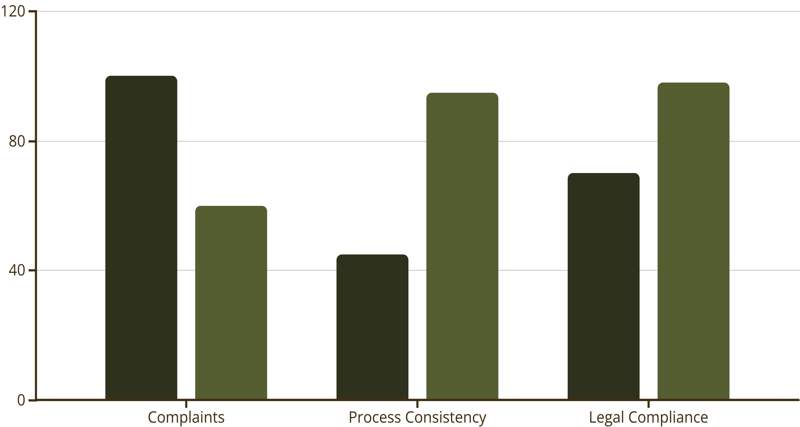
Visualising Policy Impact: Before and After Implementation
Before: Unstructured Approach
Inconsistent hiring decisions with subjective criteria
Variable interview processes across departments
Potential for unconscious bias to influence outcomes
Limited documentation of selection rationales
Higher complaint rates and legal vulnerability
After: Structured Compliance Framework
Standardised, merit-based evaluation criteria
Consistent interview protocols with skills-based assessments
Comprehensive training on bias recognition and legal requirements
Detailed documentation at every recruitment stage
40% reduction in complaints and improved workforce quality
Before
After

Slide 9




Building a Culture of Compliance and Respect
Leadership Commitment
Continuous Education
Visible executive commitment to equality and transparency drives policy effectiveness throughout the organisation.
Regular training programmes and open dialogue empower all employees to understand and uphold equality standards.
Accountability Systems
Inclusive Networks
Implement measurable accountability mechanisms ensuring policies translate into consistent workplace behaviours and outcomes.
Utilise employee resource groups inclusively without restricting membership by protected traits, fostering belonging for all.
Sustainable cultural change requires aligning organisational values, leadership actions, operational procedures, and individual behaviours around shared commitments to merit, fairness, and respect.

Slide 10

Embedding Equality for Sustainable Organisational Success
Legal Protection
Operational Excellence
Long-Term Resilience
Translating law into practice protects organisations from liability whilst demonstrating commitment to lawful, ethical operations in all employment decisions.
Thoughtful policies, ethical complaint handling, and robust codes of conduct create fair, productive workplaces where talent thrives on merit.
Commitment to merit-based opportunity and respectful treatment ensures organisational resilience and adaptability amid evolving legal requirements and social expectations.
"Organisations that embed equality into their DNA—through policy, practice, and culture—create sustainable competitive advantage whilst fulfilling their legal and ethical obligations to all employees."

