Slide 1



Erasmus+ Programme – KA220-VET - Cooperation partnerships in vocational education and training
INCLUDE - 2023-1-RO01-KA220-VET-000160043
Unemployment in Athlone: A Regional Labour Market Overview
Understanding labour market dynamics in Ireland's Midlands through data-driven analysis and regional economic trends

Slide 2
Athlone: Economic Heart of the Midlands
Athlone stands as a key urban centre in County Westmeath, positioned strategically within Ireland's Midlands Region. With a population of approximately 22,800 residents according to the 2022 census, the town serves as one of the main regional hubs for employment and services across the midlands.
22.8K
Population
The town's central location and robust infrastructure have established it as a vital economic anchor, supporting diverse employment sectors including retail, healthcare, education, logistics, and light manufacturing. This economic diversification provides Athlone with greater resilience compared to more rural areas of the county.
2022 census figure
1
Regional hub
Main employment centre

Slide 3

Data Limitations and Regional Context
Local Data Availability
County-Level Indicators
Specific monthly unemployment figures for Athlone alone are not routinely published by the Central Statistics Office (CSO). Labour market analysis must therefore rely on broader county-level data to understand local trends.
County Westmeath unemployment data from the April 2022 census provides the most reliable proxy for understanding Athlone's labour market conditions, given the town's role as the principal employment centre.
Regional Benchmarking
Athlone typically mirrors county labour market trends whilst often benefiting from greater economic diversification and stronger connectivity to larger labour markets compared with more rural parts of Westmeath.

Slide 4
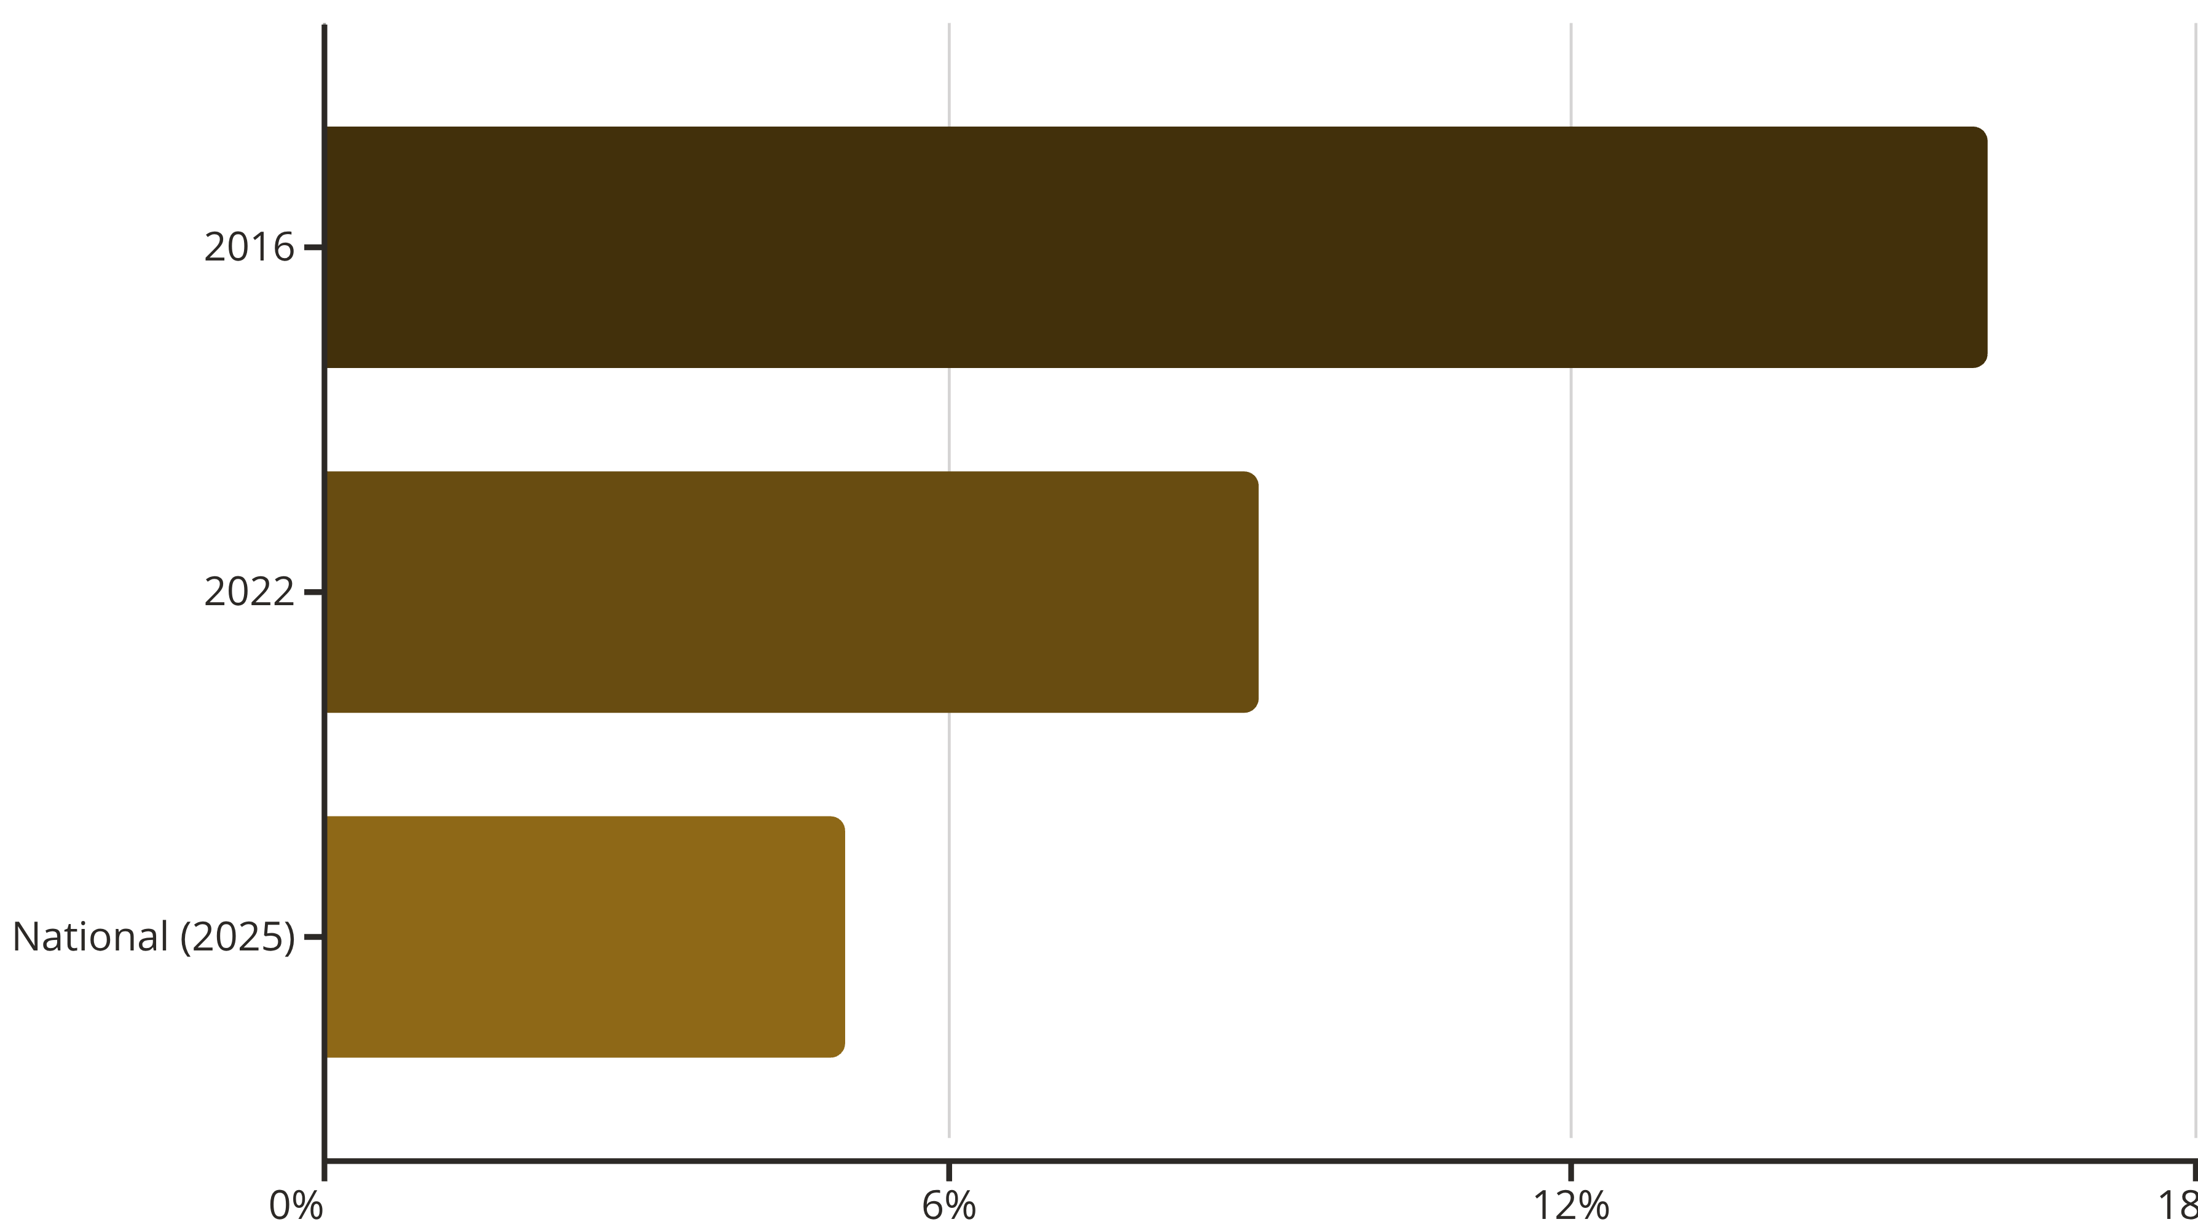
Westmeath Unemployment: A Story of Improvement
County Westmeath has experienced a remarkable transformation in its labour market over recent years, with unemployment rates declining substantially from post-crisis peaks.
The unemployment rate in Westmeath stood at approximately 9% in 2022, representing a substantial decline from 16% in 2016. Whilst this improvement is significant, the county rate remains above the current national unemployment rate, suggesting ongoing structural challenges in the regional labour market.

Slide 5

National Labour Market Context
Ireland's Strong Performance
At the national level, Ireland's official unemployment rate has fluctuated around 4.7%–5% in 2025, according to the latest seasonally adjusted labour force data from the Central Statistics Office and economic monitoring sources.
This overall Irish unemployment rate places Ireland amongst countries with relatively low joblessness within the EU context, reflecting the country's robust economic recovery and continued growth across multiple sectors.
However, regional variations persist, especially between urban centres and more rural or peripheral areas, highlighting the importance of place-based labour market analysis.

Slide 6


Athlone's Economic Sectors
Athlone benefits from substantial economic diversification across multiple employment sectors, providing resilience and opportunity for job seekers across varied skill levels and occupational categories.
Retail & Services
Significant employment in retail trade, hospitality, and consumer services, serving both local residents and the broader Midlands catchment area.
Health & Education
Major employers include healthcare facilities and educational institutions, providing stable professional employment opportunities.
Logistics & Manufacturing
Strategic location supports logistics operations and light manufacturing, leveraging connectivity to national transport networks.

Slide 7
Labour Market Demand Indicators
Online Job Postings
Sectoral Growth
Recent job postings on platforms such as Indeed reflect a range of openings across Athlone's diverse sectors, indicating ongoing demand across multiple occupational categories.
The town's economic diversification continues to support employment creation, with particular strength in service sectors and logistics operations benefiting from Athlone's central location.
Retail and customer service roles
Healthcare and social care positions
This variety of opportunities helps to absorb job seekers with different skill sets and experience levels, contributing to the overall reduction in unemployment rates.
Administrative and office support
Technical and skilled trades

Slide 8
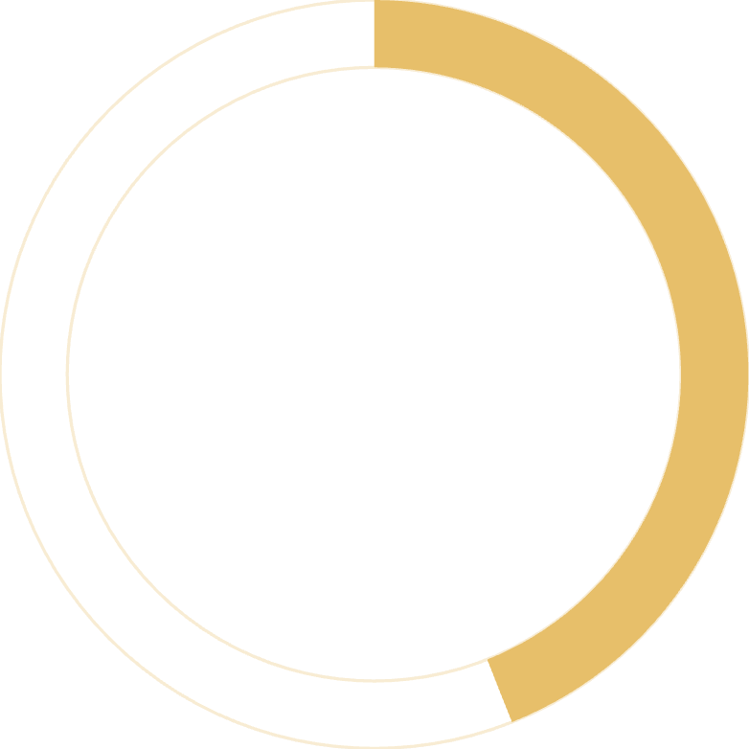
Progress Over Time: A Positive Trajectory
The county-wide unemployment reduction from 16% in 2016 to approximately 9% in 2022 suggests significant labour market improvement over time in Athlone's broader catchment area.
This substantial decline reflects:
44%
Economic recovery following the financial crisis and subsequent challenges
Job creation across multiple sectors in the Midlands region
Improved labour market matching between job seekers and available opportunities
Enhanced training and education programmes supporting workforce development
Even with this progress, local rates may vary by neighbourhood and demographic group, suggesting that targeted interventions may still be necessary for specific populations facing barriers to employment.
Reduction achieved
Decline from 2016 to 2022

Slide 9

Key Insights for Policymakers
01
National strength, regional variation
Whilst Ireland's national unemployment remains low at around 5%, Westmeath's 9% rate indicates that labour market conditions vary significantly by region, requiring place-based policy responses.
02
Progress but gaps remain
The substantial improvement in Westmeath unemployment since 2016 demonstrates the effectiveness of economic recovery, yet the gap with national rates suggests ongoing structural challenges.
03
Diversification as strength
Athlone's diverse employment base across retail, services, healthcare, education, and logistics provides resilience and varied opportunities, supporting continued labour market improvement.
04
Data needs
More granular, town-level unemployment data would enable better-targeted interventions and more precise monitoring of local labour market conditions.

Slide 10

Summary: Athlone's Labour Market Outlook
Current Position
Looking Forward
No precise current unemployment rate for Athlone alone
is regularly published by official sources.
County Westmeath figures from the 2022 census indicate a substantial decline in joblessness to approximately 9%, down from 16% in 2016.
National unemployment in Ireland remains relatively low at around 5% in late 2025, suggesting that labour market conditions in Athlone and surrounding counties are likely influenced by broader economic strength.
Local structural factors continue to shape employment opportunities in Athlone, even as the town benefits from Ireland's overall economic performance.
Ongoing monitoring of regional labour market trends, continued economic diversification, and targeted support for those facing employment barriers will be essential for further progress.

