Slide 1



Erasmus+ Programme – KA220-VET - Cooperation partnerships in vocational education and training
INCLUDE - 2023-1-RO01-KA220-VET-000160043
Unemployment and Mining in Vâlcea County
An analysis of labour market dynamics and structural changes in a historically mining-dependent region of Romania

Slide 2
Current Labour Market Overview
Registered Unemployment Statistics
National Context
As of November 2025, Vâlcea County reported a registered unemployment rate of 3.09%, with approximately 4,092 jobseekers officially registered with the county employment agency AJOFM Vâlcea. This figure represents a slight increase from earlier in the year, when rates hovered around 2.55%–2.64% during May and June 2025.
Romania's national unemployment rate stood at approximately 5.9% in late 2025 according to Eurostat labour force surveys, indicating that Vâlcea's registered unemployment is significantly below the national average.
However, it is important to note that registered rates are typically lower than survey-based unemployment figures because many unemployed individuals are not registered at employment offices or are engaged in informal employment activities that official statistics do not capture.
These figures refer specifically to registered unemployment — individuals who have formally signed up with local labour offices — which is one of the standard administrative indicators used throughout Romania to monitor regional employment dynamics.

Slide 3
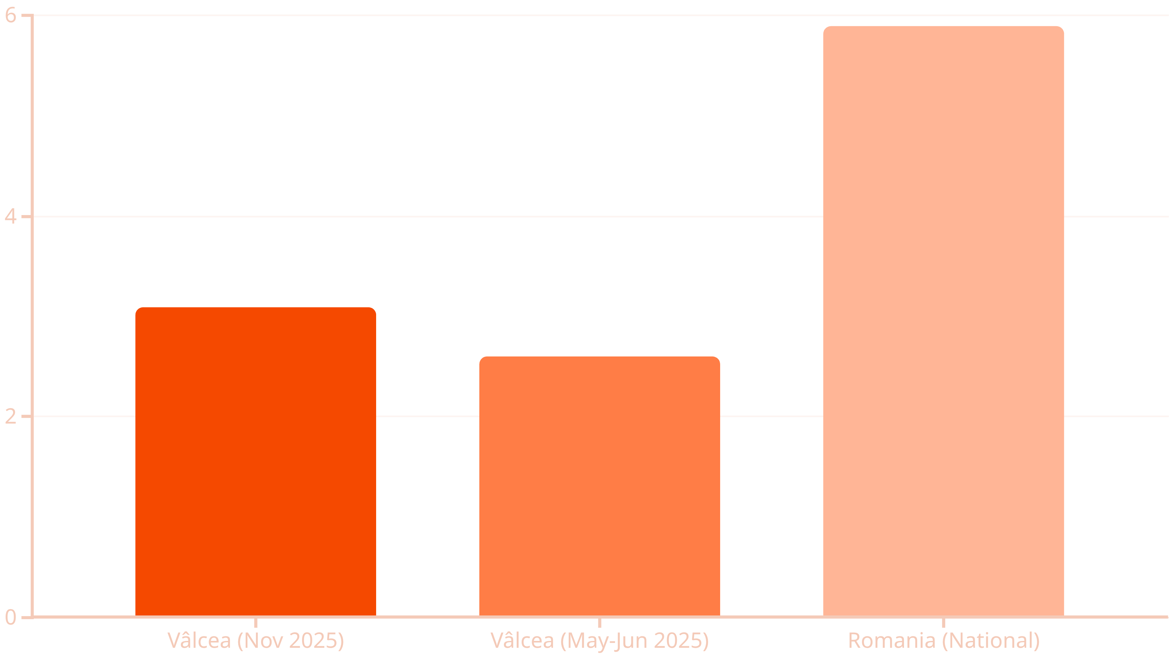
Unemployment Rate Comparison
Vâlcea County consistently maintains unemployment levels well below the national average, suggesting relatively active local labour market dynamics and employment opportunities compared to other Romanian regions. The modest increase from mid-year to November 2025 reflects seasonal variations and evolving economic conditions.

Slide 4
Understanding the Data Limitations
Registered vs. Actual Unemployment
Informal Employment
Underemployment and Hidden Unemployment
Significant portions of the workforce, especially in rural areas, may be engaged in informal work arrangements that are not reflected in official statistics, making the true employment picture more complex than registered figures suggest.
Administrative unemployment data capture only those who officially register with employment offices, excluding many job seekers who do not engage with formal systems or who have become discouraged from active job search.
The data do not fully capture underemployment (workers in jobs below their skill level or working fewer hours than desired) or discouraged workers who have stopped actively seeking employment, both significant factors in regions undergoing economic transition.

Slide 5
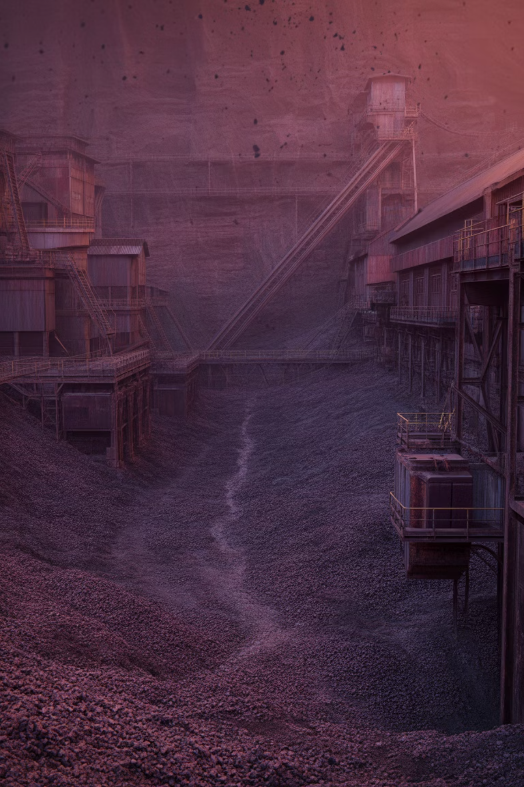
Mining's Historical Role in Vâlcea
The Berbești Coal Mine
Economic Impact
Located in Berbești, Vâlcea County, this lignite extraction site has historically been one of the major coal mining operations in Romania. Operated by the state-owned National Company of Lignite Oltenia, the Berbești mine has possessed notable reserves and employed a substantial workforce, serving as a crucial economic anchor for the local community.
Direct employment of hundreds of miners
Supporting jobs in supply chains and services
Infrastructure development
Local economic multiplier effects
Beyond coal, the region also features other extractive activities including salt mining at Salina Ocnele Mari, limestone quarrying, and extraction of feldspath and other minerals, contributing to a diverse extractive industry base.

Slide 6

Mining as a Structural Economic Pillar
Direct Employment
Supply Chain Effects
Community Anchor
The Berbești mining basin historically supported hundreds of jobs directly in extraction operations, providing stable wages and employment security for local families.
Mining operations generated substantial indirect employment in associated services, equipment supply, transportation, and maintenance sectors.
As a major employer, mining provided economic stability to entire communities, supporting local businesses and public services through tax revenues and purchasing power.
In regions where extractive industries dominate, mining traditionally functions as an economic cornerstone, shaping local labour markets and community development patterns for generations.

Slide 7




The Decline of Romanian Coal Mining
Romania's coal and lignite mining sector has faced significant contraction over recent decades, driven by multiple converging pressures that fundamentally reshape the industry and its role in the national economy.
Structural Economic Shifts
Market forces and competitiveness challenges reduce coal's economic viability
Climate Policy
European and national commitments to reduce carbon emissions drive energy transition
Energy Sector Restructuring
Power plants reduce reliance on lignite in favour of cleaner alternatives
These trends are visible at the national scale, with coal employment shrinking substantially as Romania aligns its energy sector with EU climate targets and economic modernisation objectives.

Slide 8

Immediate Crisis: Job Loss Risk in Berbești
⚠️ February 2025 Warning
Approximately 450 miners in the Berbești-Alunu coal basin were reported at risk of losing their jobs if mining operations were not extended.
Recent reports from early 2025 highlighted an acute employment crisis facing the Berbești mining community. Planned closures linked to broader energy transition policies and economic restructuring threatened to eliminate hundreds of jobs in a region where alternative employment opportunities remain limited.
Direct Impact
Ripple Effects
450 miners facing potential unemployment
Reduced household incomes affecting local businesses
Loss of stable, relatively well-paid jobs
Decreased tax revenues for local authorities
Specialised workforce with limited transferable skills
Pressure on social services and support systems
Concentration of job losses in single localities
Potential out-migration of working-age population

Slide 9

Mining Contraction and Unemployment Linkages
Mine Closure
Direct Job Losses
Reduced Household Income
Lower Local Spending
The relationship between mining sector contraction and local unemployment is clear and well-documented. When a dominant industry like mining contracts or closes, the effects cascade through the local economy, creating both immediate job losses and longer-term structural unemployment challenges.
In single-industry localities such as Berbești, where mining has historically been the primary employer, alternative opportunities are often scarce. Displaced workers face significant barriers: their specialised skills may not transfer easily to other sectors, geographic mobility may be constrained, and local labour demand may be insufficient to absorb redundant workers.

Slide 10


The Paradox: Low Registered Unemployment
3.09%
450
Registered Rate
At-Risk Miners
Official unemployment in Vâlcea remains relatively low despite mining pressures
Workers facing potential job loss in Berbești-Alunu basin
Despite significant job loss risks in the mining sector, Vâlcea County's registered unemployment remains relatively low at around 3%. This apparent paradox suggests several possible labour market dynamics at work simultaneously.
Possible Explanations
Hidden Realities
Successful transition of workers to other sectors
Low registered unemployment may mask significant structural challenges including underemployment, discouraged workers who have stopped actively seeking jobs, and informal employment that provides income but lacks stability and social protection.
Early retirement of older miners
Self-employment and informal work
Out-migration to other regions or abroad
Non-registration with employment offices

Slide 11

Structural Unemployment Challenges
Structural unemployment arises when the skills of displaced workers do not match available jobs in the local labour market — a phenomenon particularly acute in regions undergoing industrial transition from resource extraction to more diversified economic bases.
Skills Mismatch
Adjustment Time
Mining-specific skills have limited transferability to emerging sectors
Retraining and economic diversification require years to implement
1
2
3
4
Geographic Barriers
Persistent Effects
Jobs may exist elsewhere but relocation is costly and difficult
Long-term unemployment and reduced lifetime earnings affect communities
This pattern is well documented in transition economies and resource-dependent localities globally, where industrial restructuring creates significant labour market adjustment costs that extend well beyond the initial job losses.

Slide 12
Policy Responses and Labour Market Interventions
Retraining Programmes
Relocation Support
Active labour market policies providing vocational training and skills development to help displaced miners transition to new sectors such as renewable energy, construction, services, and digital economy roles.
Financial and logistical assistance for workers willing to move to regions with better employment opportunities, reducing geographic barriers to labour market adjustment and matching skills with demand.
Enterprise Development
Investment Attraction
Support for small business creation and entrepreneurship to absorb redundant labour and stimulate local economic diversification, including access to credit, business training, and reduced regulatory barriers.
Targeted efforts to attract new industries and employers to mining-dependent regions through infrastructure improvements, tax incentives, and coordinated regional development strategies.

Slide 13
Economic Diversification Strategies
Addressing unemployment tied to mining decline requires fundamental economic diversification — moving from dependence on a single extractive industry to a more varied economic base capable of generating sustainable employment opportunities.
Service Sector Growth
Light Manufacturing
Developing retail, hospitality, healthcare, education, and business services to create employment across skill levels and provide economic stability.
Attracting manufacturing enterprises that can leverage local workforce capabilities and transportation infrastructure to produce goods for domestic and export markets.
Tourism Development
Rural Enterprise
Capitalising on cultural heritage and natural assets such as Salina Ocnele Mari to create visitor experiences, hospitality jobs, and related business opportunities.
Supporting agricultural diversification, agrotourism, traditional crafts, and small business development in rural communities to provide alternatives to industrial employment.

Slide 14

Just Transition Principles
Aligning with European Frameworks
The European Union's Just Transition Mechanism recognises that the shift away from fossil fuels must not leave workers and communities behind. This framework provides financial support and policy guidance for regions like Vâlcea undergoing energy transition.
Just Transition principles emphasise:
Social dialogue with affected workers and communities
Comprehensive retraining and reskilling programmes
Investment in alternative economic activities
Income support during transition periods
Environmental remediation of former industrial sites
Romania's alignment with these principles is critical for managing the social costs of mining decline whilst achieving climate objectives.

Slide 15
Key Takeaways: Vâlcea's Labour Market Transition
01
02
Mining's Historical Importance
Structural Decline Pressures
The Berbești coal mine and related extractive industries have been significant employers, providing stable jobs and economic anchor effects for local communities in Vâlcea County.
Planned closures and contraction in coal mining pose serious unemployment risks, with approximately 450 miners facing potential job losses, creating acute adjustment pressures.
03
04
Complex Labour Market Reality
Need for Active Intervention
Whilst registered unemployment remains low (3.09%), this may mask labour market transitions, underemployment, informal work, and out-migration rather than reflecting successful local job creation.
Economic diversification, comprehensive retraining programmes, and alignment with Just Transition principles are essential for mitigating unemployment and ensuring sustainable post-mining economic development.
Vâlcea County faces significant labour market challenges as it navigates the decline of its historic mining sector. Success will require coordinated policy responses, substantial investment in alternative economic activities, and sustained commitment to supporting affected workers and communities through this fundamental transition.

