Slide 1



Erasmus+ Programme – KA220-VET - Cooperation partnerships in vocational education and training
INCLUDE - 2023-1-RO01-KA220-VET-000160043
Labour Market Dynamics in Molise
Understanding employment challenges in one of Southern Italy's smallest regions

Slide 2
Regional Context and Economic Profile
Molise stands as one of the smallest and least populous regions in Southern Italy, presenting distinctive labour market patterns within the broader Italian and European context. The region's economic structure is characterised by a substantial agricultural sector alongside smaller industrial and tertiary sectors, contributing to unique employment challenges.
Agricultural Focus
Substantial rural economy with traditional sectors
Its rural profile and relatively low population density correlate with constrained job creation opportunities and higher out-migration amongst working-age residents. These structural characteristics shape the region's labour market dynamics and distinguish it from more economically dynamic Italian regions such as Lombardy or Emilia-Romagna.
Limited Industry
Smaller industrial base constrains employment
Population Density
Low density affects labour market vitality

Slide 3

Current Unemployment Snapshot
9.6%
7.6%
2pp
Molise Rate (2023)
National Average
Gap Above National
Regional unemployment according to Eurostat data
Italian unemployment benchmark for comparison
Molise's unemployment exceeds Italian average
According to Eurostat data for 2023, Molise's unemployment rate of approximately 9.6% positions the region around two percentage points above the national Italian average. This elevated incidence of joblessness reflects both regional economic limitations and structural challenges that distinguish Molise from more prosperous Italian regions.

Slide 4
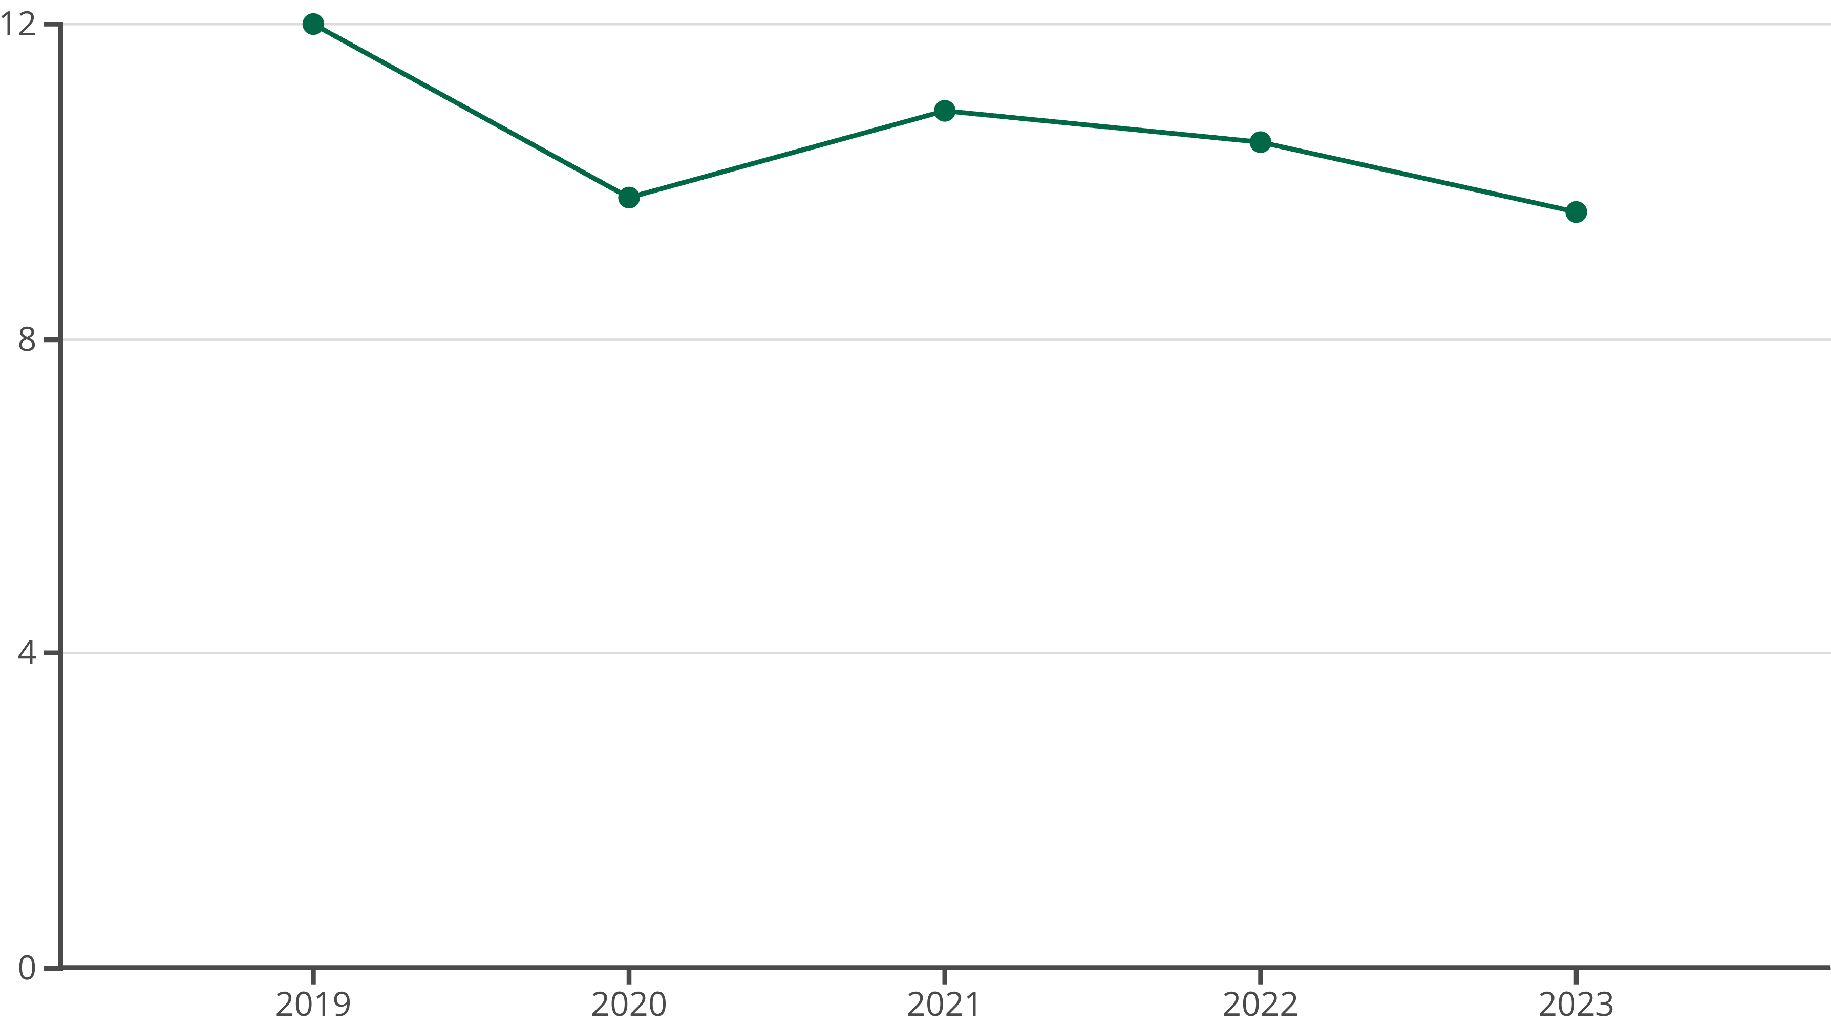
Historical Unemployment Trends (2019–2023)
Comparative data reveal fluctuations in Molise's unemployment rate over recent years, with a moderate downward trend following COVID-19 pandemic disruptions. However, levels remain elevated when benchmarked against Italy's overall unemployment trajectory, indicating persistent structural challenges.
Regional media and ISTAT-based reports from 2024 indicate short-term volatility, with local estimates highlighting unemployment rates around 11% at certain points in early 2024—amongst the higher regional rates nationally.

Slide 5

Structural Labour Market Characteristics
Youth Unemployment
Youth unemployment in Molise is markedly higher than general unemployment rates—a common pattern across Southern Italy. This reflects mismatches between education, skills, and labour demand, as well as regional economic under-development affecting young people's entry into the workforce.
Gender Disparities
Statistical profiles underscore lower employment rates amongst women compared to men, consistent with socio-economic gender gaps historically documented in Southern European contexts. Molise's labour force participation and employment performance for women remain below the Italian average.

Slide 6

Key Determinants of Regional Unemployment
Economic Structure
Out-Migration
The region's economic composition—substantial agricultural sector with smaller industrial and tertiary sectors—limits diverse employment opportunities and contributes to higher unemployment rates.
Rural profile and low population density correlate with lower job creation, driving working-age residents to seek opportunities elsewhere, further constraining regional labour markets.
Skills Mismatch
Economic Stagnation
Disparities between educational attainment and labour market demand create structural unemployment, particularly affecting young people and limiting economic mobility.
Weak demand and sectoral rigidities persist, reflecting broader patterns identified across the Italian Mezzogiorno and Southern European labour markets.

Slide 7

Comparative Regional Analysis
Molise's situation aligns with broader analyses of regional unemployment in Southern Europe, where structural unemployment persists due to weak demand, sectoral rigidities, and demographic pressures. Studies of Italian labour markets underscore the interplay of educational attainment, labour force participation, and economic stagnation as determinants of regional unemployment disparities.
Southern Italy Pattern
Northern Contrast
Molise reflects challenges common across the Mezzogiorno: elevated unemployment, youth joblessness, and gender disparities in labour force participation.
Regions such as Lombardy and Emilia-Romagna demonstrate substantially lower unemployment rates, driven by diversified economies and stronger industrial bases.
European Context
Molise's labour market challenges mirror patterns observed across Southern European regions facing structural economic limitations and demographic shifts.

Slide 8

Policy Responses and Interventions
National and EU-Level Initiatives
National and EU-level initiatives aim to stimulate active labour market policies and enhance employability in regions like Molise. Key programmes include:
01
02
Garanzia di Occupabilità dei Lavoratori (GOL)
Piano Nazionale di Ripresa e Resilienza (PNRR)
Active labour market policy framework targeting employability enhancement
National recovery plan incorporating retraining schemes and regional development initiatives
03
Regional Implementation
Localised programmes adapting national frameworks to Molise's specific labour market needs

Slide 9

Academic and Scholarly Perspectives
From an academic standpoint, the situation in Molise aligns with broader analyses of regional unemployment in Southern Europe: structural unemployment persists due to weak demand, sectoral rigidities, and demographic pressures.
Studies of Italian labour markets underscore the interplay of educational attainment, labour force participation, and economic stagnation as determinants of regional unemployment disparities. Broader European research on youth unemployment and structural mismatches provides frameworks for understanding Molise's challenges.
Whilst specific localised studies on Molise are less prominent in international literature, regional reports reflect similar patterns to those identified throughout the Italian Mezzogiorno. The region serves as a microcosm of broader Southern European labour market dynamics, offering insights into persistent structural challenges facing peripheral regions.

Slide 10
Key Takeaways and Future Outlook
Elevated Unemployment
Vulnerable Groups
Molise's 9.6% rate exceeds national average by 2 percentage points, reflecting structural economic challenges
Youth and women face disproportionate employment barriers, requiring targeted policy interventions
Structural Factors
Policy Framework
Economic composition, skills mismatch, and demographic pressures drive persistent unemployment patterns
National and EU initiatives provide mechanisms for addressing regional labour market challenges through active policies
Addressing Molise's labour market challenges requires sustained policy commitment, structural economic diversification, and targeted interventions addressing youth unemployment and gender disparities. The region's trajectory will depend on successful implementation of recovery programmes and broader economic development initiatives.

