Slide 1

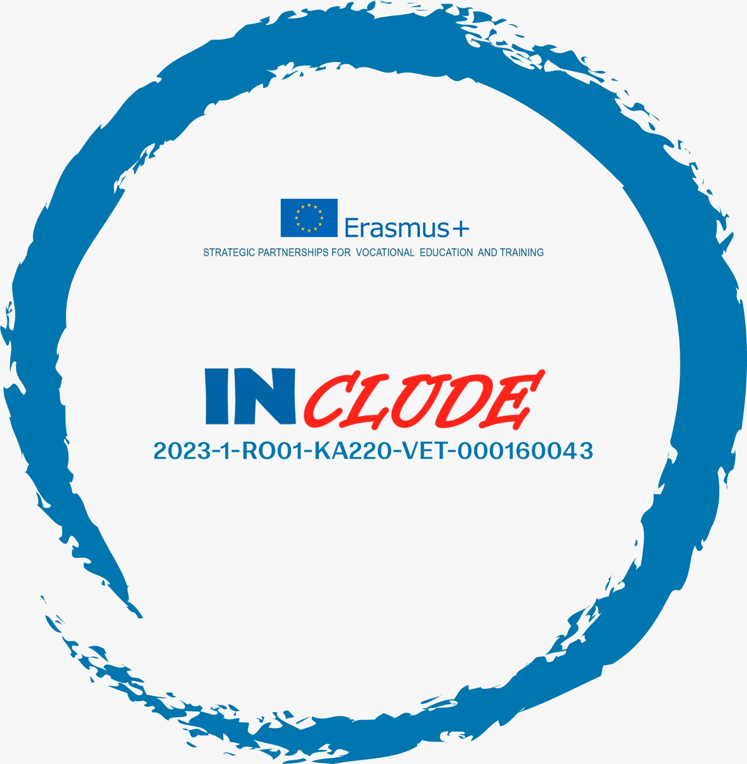

Erasmus+ Programme – KA220-VET - Cooperation partnerships in vocational education and training
INCLUDE - 2023-1-RO01-KA220-VET-000160043
Combating Unemployment in Regione Molise
A comprehensive multi-layered strategy combining regional, national, and EU-supported policies to address structural unemployment in a small peripheral Italian region

Slide 2

Strategic Framework Overview
The Regione Molise employs a sophisticated mix of coordinated policies that reflect broader Italian labour frameworks whilst addressing the unique challenges of a small, peripheral region. This approach integrates active labour market measures with training services, entrepreneurship support, and robust governance structures.
The strategy builds upon national programmes such as ANPAL's GOL initiative, adapting them to Molise's specific structural conditions. By combining European Social Fund resources with regional interventions, the region creates a comprehensive ecosystem designed to enhance employability and stimulate job creation.
Active Labour Market Services
Training & Skills Development
Entrepreneurship Support
Personalised placement and job search support tailored to individual needs
Vocational education and labour market intelligence systems
Financial incentives and business creation schemes for new enterprises

Slide 3

Active Labour Market Policies
GOL Programme Implementation
Key Participant Groups
Long-term unemployed individuals
Molise implements the national Garanzia di Occupabilità dei Lavoratori (GOL) programme, a comprehensive framework delivering personalised services for jobseekers. This initiative focuses on three core pillars: employability enhancement, upskilling existing competencies, and reskilling for emerging sectors.
Youth jobseekers
Women returning to work
People with disabilities
The programme specifically targets priority groups including long-term unemployed individuals, youth entering the labour market, women re-entering employment, people with disabilities, and low-income workers requiring additional support. Services are delivered through Centri per l'Impiego and accredited private entities, creating an integrated network of support.
Low-income workers
Programme funded through PNRR Recovery and Resilience Plan resources

Slide 4





GOL Programme Pathways
Reinsertion into Employment
Direct placement support for immediate job opportunities
Training & Upskilling
Enhancement of existing skills to meet current market demands
Reskilling for New Sectors
Complete career transition support for emerging industries
Social Inclusion Activities
Comprehensive support addressing barriers to employment
Each pathway is carefully designed through Individual Service Agreements that formalise personalised action plans between jobseekers and Public Employment Services, ensuring targeted and measurable outcomes.

Slide 5

Subsidised Work Placements & Practical Experience
Borse Lavoro Programme
Regional initiatives provide six-month work grants (borse lavoro) designed specifically for jobseekers without income support. These temporary placements create valuable bridges between unemployment and stable employment.
Participants gain real-world professional experience in supportive workplace environments, developing both technical skills and workplace competencies. The programme facilitates smoother transitions back into the labour market whilst providing employers with supported recruitment opportunities.
This practical approach addresses a critical gap in traditional training programmes by offering hands-on experience that enhances employability and builds professional networks essential for long-term career success.

Slide 6
Labour Market Intelligence & Training Infrastructure
Osservatorio del Mercato del Lavoro
Vocational & Adult Education Integration
The region's labour market observatory serves as a critical analytical infrastructure, systematically collecting and disseminating comprehensive data on local employment trends, skills mismatches, and sectoral developments.
Molise mobilises national frameworks including PNRR and European Social Fund resources to strengthen vocational education and training (VET) systems. These programmes enhance employability by adapting skills provision to current and anticipated labour demand.
This intelligence directly informs policy design, enabling evidence-based interventions that anticipate rather than react to labour market changes. The observatory's insights support strategic regional planning and ensure resources are directed towards areas of greatest need and opportunity.
Adult education schemes provide opportunities for continuous learning and career development, ensuring that workers can adapt to evolving technological and economic landscapes throughout their professional lives.

Slide 7
Entrepreneurship & Business Creation
Stimulating Job Creation Through Enterprise
Recognising that traditional employment channels alone cannot address regional unemployment, Molise implements comprehensive entrepreneurship support programmes that empower individuals to create their own opportunities and generate employment for others.
Creazione di Impresa Programme
Ongoing Business Support
Financial and technical support for unemployed individuals launching micro-enterprises
Continued guidance and resources ensuring long-term enterprise sustainability
1
2
3
Progetto Policoro
Community-driven initiative providing counselling, networking, and youth entrepreneurship support
Regional Business Creation Calls
Grassroots Community Support
Targeted funding initiatives support aspiring entrepreneurs in establishing viable businesses outside traditional employment structures, stimulating innovation and diversifying the regional economy.
Complementary initiatives led by ecclesiastical and civil society organisations provide additional mentoring and networking opportunities, creating a comprehensive support ecosystem.

Slide 8
Governance & Service Delivery Infrastructure
Strengthening Public Employment Services
Effective unemployment intervention requires robust institutional capacity. Molise has prioritised strengthening its Public Employment Services (PES) through strategic partnerships with organisations such as Sviluppo Lavoro Italia, ensuring comprehensive service delivery across diverse population groups.
01
02
Enhanced Service Coordination
Specialised Support Provision
Improved integration between public services, private partners, and data observatories creates seamless support pathways
Tailored assistance for migrants, social income beneficiaries, and other vulnerable groups ensures inclusive service delivery
03
04
Individual Service Agreements
Quality Assurance & Monitoring
Personalised action plans (patti di servizio) formalise commitments between jobseekers and employment services, specifying training, placement, and job search activities
Systematic evaluation ensures services remain effective, responsive, and aligned with evolving labour market needs

Slide 9
National & European Support Mechanisms
National Labour Incentives
European Structural Support
Whilst not exclusively regional, national contributory reliefs for employers hiring in southern regions significantly benefit Molise. These measures, including exemptions introduced in the 2025 budget law, reduce hiring costs and stimulate labour demand.
The European Social Fund (ESF) and National Youth Guarantee frameworks provide crucial structural support for training and youth employment initiatives.
Molise harnesses these resources through carefully designed operational programmes that align European priorities with regional needs, maximising available funding whilst ensuring local policy coherence.
Temporary incentives create immediate employment opportunities whilst longer-term structural interventions address underlying economic challenges facing peripheral regions.
Critical Funding Streams: PNRR Recovery and Resilience Plan, European Social Fund, National Youth Guarantee, and regional operational programmes work in concert to support comprehensive unemployment interventions

Slide 10





An Integrated Multi-Layered Strategy
Molise's approach demonstrates that addressing unemployment in peripheral regions requires sophisticated coordination across multiple policy domains, institutional levels, and stakeholder groups. Success depends on integrating active labour market services with skills development, entrepreneurship support, and robust governance structures.
Training & Skills
Active Labour Market Services
VET systems and labour market intelligence
Personalised placement and comprehensive job search support
Entrepreneurship
Financial incentives and business creation schemes
Community Initiatives
Complementary grassroots support networks
Institutional Capacity
Enhanced coordination and service delivery
This comprehensive framework positions Molise to address both immediate unemployment challenges and longer-term structural economic transformation, creating sustainable pathways to employment that strengthen regional resilience and prosperity.

