Slide 1

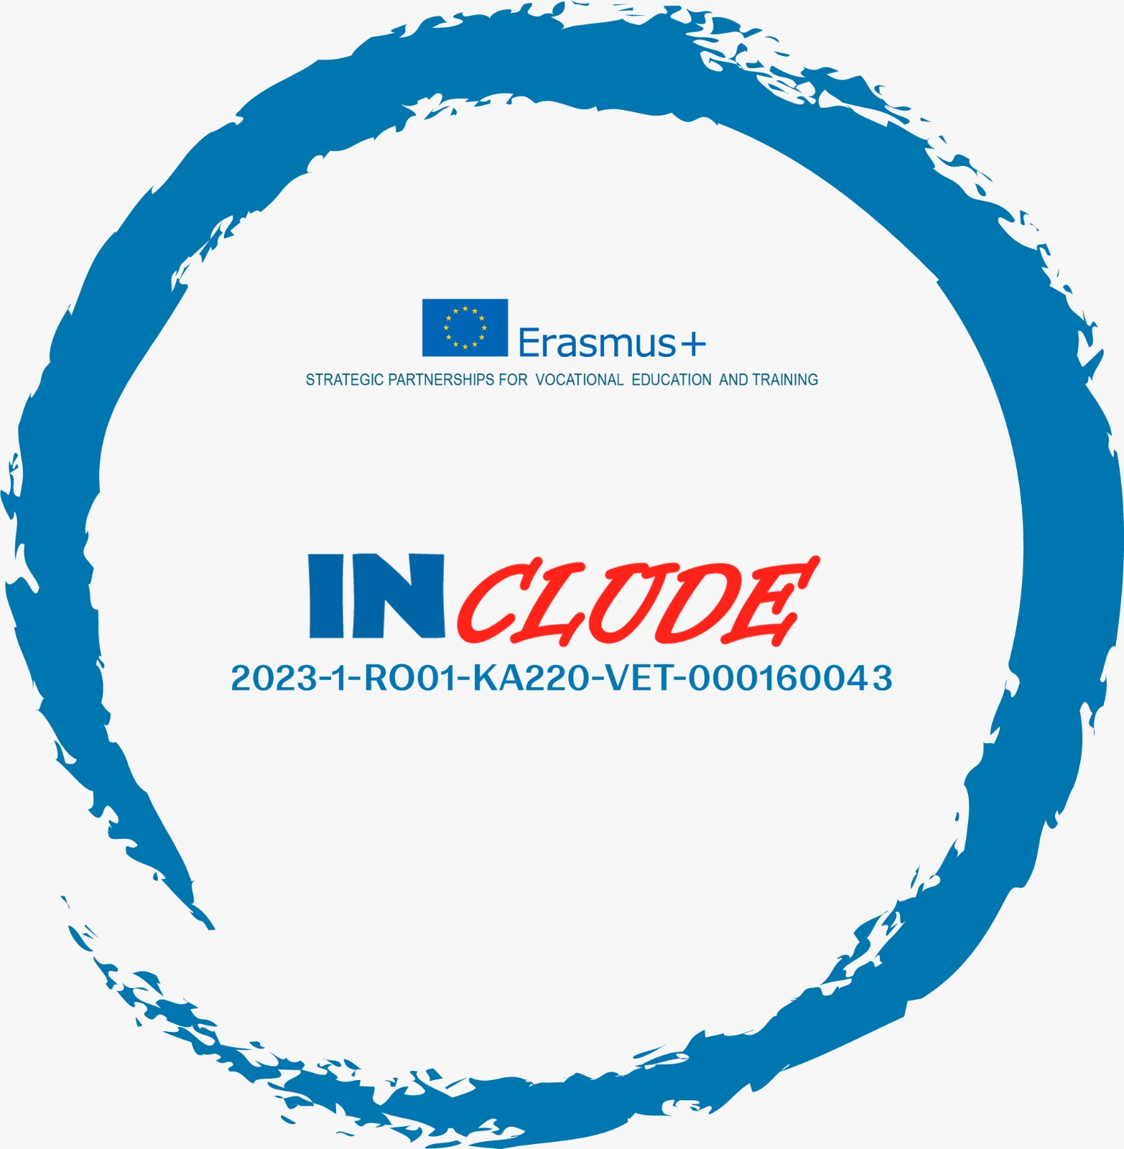

Erasmus+ Programme – KA220-VET - Cooperation partnerships in vocational education and training
INCLUDE - 2023-1-RO01-KA220-VET-000160043
Combating Unemployment in Athlone, Ireland
A multi-level governance framework combining national labour market policies, regional development strategies, and local activation measures

Slide 2

Understanding Athlone's Employment Context
Athlone, strategically positioned in the Irish Midlands, serves as a regional growth centre under Ireland's spatial planning strategy. The town's unemployment response reflects Ireland's social-investment model of employment policy, emphasising both economic efficiency and social cohesion.
This multi-layered approach combines national frameworks with localised interventions, addressing both immediate job placement needs and long-term structural challenges. The model prioritises employability enhancement, skills adaptation, and local economic capacity building.
Ireland's comparatively low unemployment rates demonstrate the effectiveness of this integrated system, which Athlone exemplifies through coordinated action across multiple policy domains.

Slide 3

Multi-Level Governance Framework
National Level
Regional Level
Local Level
Labour market policies coordinated through Department of Social Protection
Spatial planning and infrastructure investment strategies
Community-based activation and enterprise support
Activation paradigm emphasising conditional welfare
Regional growth centre designation
Intreo office coordination
Infrastructure development
Local Enterprise Office services
Rapid labour market reintegration
Decentralisation policies
Targeted social inclusion programmes
National policy frameworks

Slide 4
Active Labour Market Policies
The Intreo Model
01
Intreo offices serve as the cornerstone of Ireland's activation system, providing integrated employment and income support services. This one-stop-shop approach reflects the activation paradigm analysed by OECD scholars such as Martin (2015) and Irish labour economists including Nolan and Callan.
Individualised Case Management
Tailored support based on jobseeker profile, skills assessment, and labour market opportunities
02
Job-Matching Services
The model emphasises mandatory activation linked to income supports, ensuring that unemployment benefits are contingent upon active job-seeking behaviour and participation in employability programmes.
Connecting unemployed persons with suitable vacancies through employer engagement and placement services
03
Mandatory Activation Requirements
Conditional welfare requiring participation in training, job search activities, or work experience
04
Labour Market Reintegration
Rapid transition from unemployment to sustainable employment with ongoing support

Slide 5
Education, Training and Skills Development
Athlone's approach to unemployment reduction places substantial emphasis on human capital development through comprehensive upskilling and reskilling programmes. This strategy echoes human-capital approaches discussed by Becker in the United States and adapted to the Irish context by Barrett.
Education and Training Boards
Apprenticeship Schemes
Regional Skills Demand Alignment
ETBs deliver further education and vocational training aligned with Midlands economic needs, focusing on sectors with strong labour demand including manufacturing, logistics, healthcare, and ICT. Programmes range from basic skills to advanced technical qualifications.
Structured work-based learning combining on-the-job training with classroom instruction. Apprenticeships provide pathways into skilled trades and emerging industries, addressing both youth unemployment and skills gaps in the regional economy.
Training provision responds to identified skills shortages in the Midlands labour market, ensuring that programme graduates possess competencies sought by local employers. This demand-led approach enhances employment outcomes and reduces skills mismatch.

Slide 6
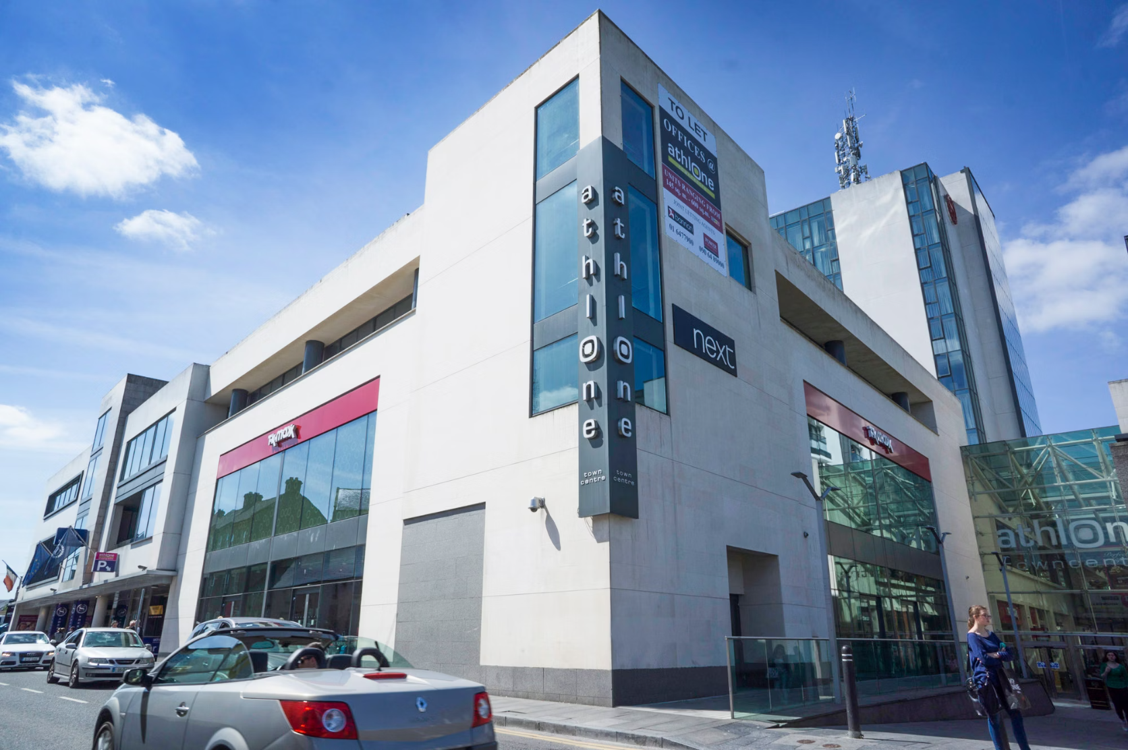
Local Enterprise and Job Creation
Enterprise Development Strategy
The Local Enterprise Office Westmeath coordinates enterprise development and SME promotion initiatives that directly combat unemployment through job creation. This endogenous development strategy aligns with regional growth theories articulated by Storper and applied to Irish regions by Breathnach.
Start-up Grants and Mentoring
Financial assistance and business advice for unemployed entrepreneurs establishing new enterprises
Business Incubation
Innovation supports, workspace, and networking opportunities for early-stage companies
Local Hiring Incentives
Programmes encouraging businesses to recruit from the local unemployed population

Slide 7





Regional and Spatial Policy Framework
Regional Growth Centre Designation
Infrastructure Investment
Athlone's status under Ireland's spatial planning strategy enhances its role as an employment hub for the Midlands, attracting investment and employment opportunities
Strategic investment in transport, digital connectivity, and public facilities strengthens labour demand and reduces barriers to employment
Decentralisation Policies
This spatial approach is consistent with EU cohesion policy principles discussed by Romanian regional economist Ionescu and Moldovan economist Stratan, recognising that addressing unemployment requires strategic investment in regional economic capacity alongside individual activation measures.
Relocation of government functions and services to Athlone creates employment whilst reducing structural unemployment in the region

Slide 8






Key Policy Instruments: An Integrated System
Skills Development
Activation Services
ETB training and apprenticeships
Intreo case management and job-matching
Enterprise Support
LEO grants and incubation
Social Inclusion
Targeted supports for vulnerable groups
Regional Development
Infrastructure and spatial planning
Unemployment in Athlone is addressed not through a single policy instrument, but via an integrated activation system that links welfare provision, training delivery, enterprise support, and regional development planning. Each element reinforces the others, creating a comprehensive response to unemployment.

Slide 9

Synthesis: A Model of Integrated Activation
The Athlone model prioritises employability enhancement, skills adaptation, and local economic capacity building, situating the town within Ireland's broader success in maintaining comparatively low unemployment rates.
Core Principles
Policy Implications
Multi-level governance coordination
Single-instrument approaches prove insufficient
Activation linked to income support
Regional context shapes policy effectiveness
Human capital investment
Integration across policy domains essential
Endogenous enterprise development
Balance between activation and social protection necessary
Social inclusion alongside efficiency

